Slide 1


Titolo presentazione sottotitolo
Simulation of Bragg Peak in Ion Beam Therapy
Study of Different Parameters of Simulation
Milano, XX mese 20XX
Milan, 6th June 2024
Petrus Canisius Astuto Santosa, Pasquale Serrao, Anna Simeone,
Alessia Zannino, Bianca Zocco

Slide 2
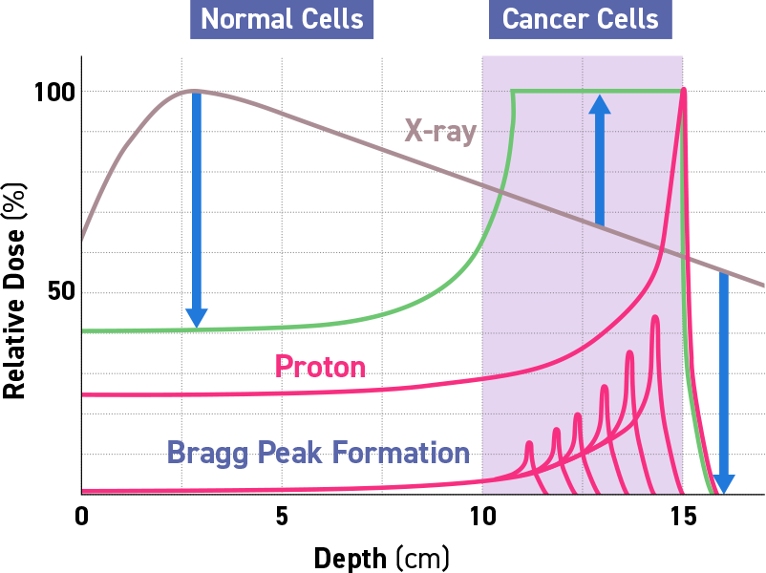
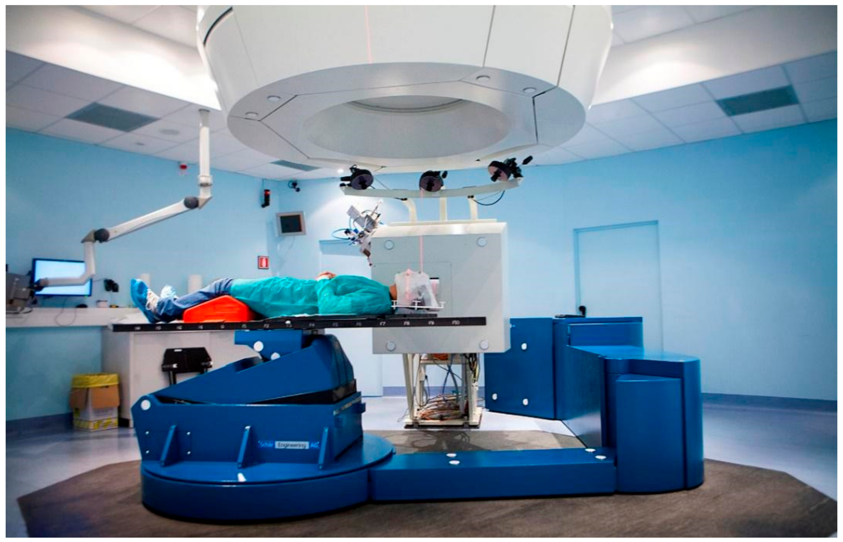
Hadrontherapy
Hadrontherapy is a form of radiotherapy for the treatment and cure of tumours.
Unlike traditional radiotherapy based on X-rays or electrons, hadrontherapy involves the use of proton and carbon ions.
(def. By CERN)
Notes:
Hadrontherapy is a form of radiotherapy for the treatment of tumors; it uses protons (or carbon ions) instead of X-rays. In fact protons can target tumors in a better way, delivering dose in a specific depth, where there is the bragg peak

Slide 3

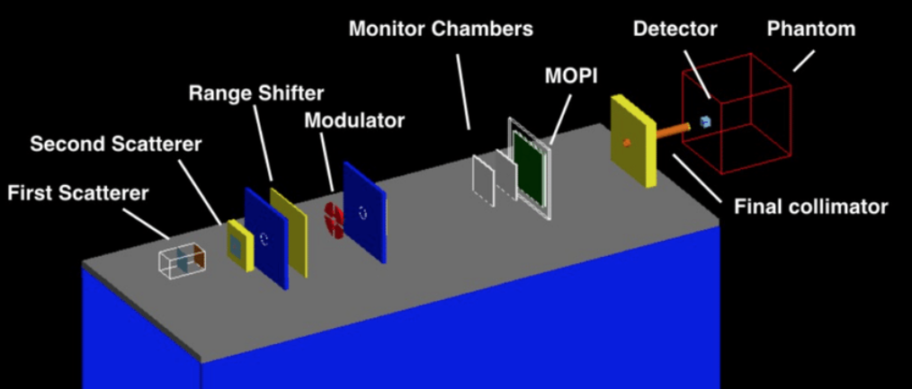
Simulation
Simulation of the ion (proton) beam facility in Catania for eye tumor treatment
Default set-up:
10000 particles
Energy of 60 MeV
Energy standard deviation 0.0 MeV
Phantom material water
Phantom dimension 40 cm x 40 cm x 40 cm
Detector dimension 4 cm x 4 cm x 4 cm
DETECTOR
Detector: 400 slices of 0.1 mm
CATANA setup implemented in Geant4
Notes:
We considered the CATANA set-up, already implemented in geant4 with the default settings written in the slide. Then we played with the detector and with the energy of the particles to make some considerations. The simulation is based on Monte Carlo tecnique and is very precise.

Slide 4
Simulation setup
SCATTERING SYSTEM: to transversally enlarge the original beam
COLLIMATORS: to collimate the beam;
RANGE SHIFTERS: to decrease the energy of the primary proton beam to a specific value;
MODULATOR WHEEL: to modulate the energy of the primary and mono-energetic beam into a wide spectrum. The energy modulation is necessary to homogeneously irradiate a tumour volume that can extend in depth up to 20 mm;
MONITOR CHAMBERS: very thin ionisation chamber that permits the dose monitoring during the patient irradiation;
MOPI detector:utilised for the check of the beam symmetry during the treatment;
PATIENT COLLIMATOR: a brass, tumour-shaped collimator able to confine the proton irradiation field to irradiate just the tumour mass in the transverse direction;

Slide 5
Simulation
CATANIA setup (implemented in Geant 4 with a Monte-Carlo simulation)
Notes:
The CATANA set-up has been considered in our project. This set-up is already implemented in Geant4; we played on the detector (inside the pantom) and on the energy of the particles (protons) to make some considerations. The simulation is based on the Monte Carlo tecnique and is very precise because it takes into account all the physic process involved in the treatment (for example electromagnetic energy loss, energy straggling, multiple Coulomb scattering, elastic and non elastic nuclear interac-tions as well as the transport of any generated secondary particle.)

Slide 6
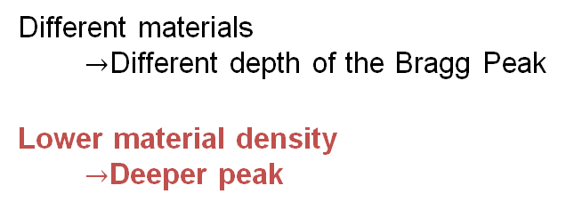
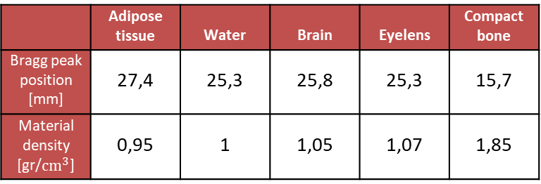
Materials
 | Adipose tissue | Water | Brain | Eyelens | Compact bone
Bragg peak position [mm] | 27,4 | 25,3 | 25,8 | 25,3 | 15,7
Material density [gr/$cm^{3}$] | 0,95 | 1 | 1,05 | 1,07 | 1,85
Different materials
$→$Different depth of the Bragg Peak
Lower material density
$→$Deeper peak
Notes:
We first explored different biological material with different densities like bones, adipose tissue, brain and eyelens. We found that brain and eyelens, which are the most used to model the eye, have the same behavior as water, so we did all the other simulation with water.

Slide 7

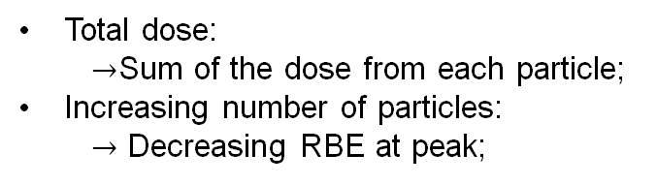
Number of particles
The relative biological effectiveness (RBE) is defined as the ratio between x-ray and particle doses required to cause the same effect in terms of Survival
Total dose:
$→$Sum of the dose from each particle;
Increasing number of particles:
$→$ Decreasing RBE at peak;
Notes:
Increasing the number of particles we found that the depth of the bragg peak is always the same, but the RBE, which is the ratio of doses required by two radiations to cause the same effect, decreases with an increasing number of particles

Slide 8
Number of particles
BIOLOGICAL DOSE
=
RBE * PHYSICAL DOSE
Physical dose peak amplitude ~ linearly dependent on the number of particles;
Biological dose shows a gradual decrease of the slope;
Notes:
As the RBE decreases we analysed the physical and biological doses. In particular we noticed that the physical dose seems to be linearly dependent on the number of particles, while the biological dose reaches a sort of saturation. We can’t be sure about it because the study of the linearity of the biological dose behavior should include more cases that were not performed because of computational limits

Slide 9
Energies
Different energies -> Different depth of the Bragg Peak;
Linear relationship between energy and peak depth;
Notes:
Then we switch on changing the energy of the beam. We saw that with higher energy, the bragg peak is more in depth and that the depth increases linearly with the energy.

Slide 10
Energy Standard Deviations Range
Remember to change the graph
Std Dev [MeV] | Diff with 0 MeV [%]
0 | 0
0,25 | 3,03
0,5 | 8,50
0,75 | 23,82
1 | 20,14
1,5 | 36,22
2 | 38,33
5 | 52,99
Ideal case: SD of 0 MeV;
Under SD of 1 MeV: at least 0.6 Gy (physical dose);
Best standard deviation in reality -> 0.4 MeV;
Notes:
In proton therapy, the standard deviation of the energy distribution of proton beams is an important parameter that affects the precision of dose delivery. Achieving a standard deviation of 0 MeV is not feasible in practical settings due to limitations in beam generation and delivery systems. However, efforts are made to minimize this spread to enhance the accuracy of treatment.
In this graph, we can see the trend of the changing standard deviation.
It will tend to lose its bragg peak when the standard deviation is higher. The range of standard deviation is below 1 MeV
Schilling I, Bäcker CM, Bäumer C, Behrends C, Hötting M, Hohmann J, Kröninger K, Timmermann B, Weingarten J. Measuring the Beam Energy in Proton Therapy Facilities Using ATLAS IBL Pixel Detectors. Instruments. 2022; 6(4):80. https://doi.org/10.3390/instruments6040080
https://www.mdpi.com/2410-390X/7/1/9#sec3dot4-instruments-07-00009
https://www.mdpi.com/2410-390X/6/4/80
https://ar5iv.labs.arxiv.org/html/2011.00285
https://www.frontiersin.org/articles/10.3389/fphy.2024.1295683/full
https://www.frontiersin.org/articles/10.3389/fphy.2022.971767/full

Slide 11
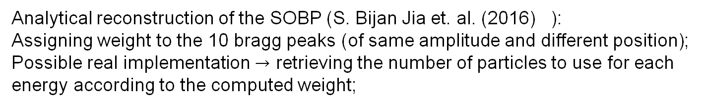
SOBP
Analytical reconstruction of the SOBP (S. Bijan Jia et. al. (2016) ):
Assigning weight to the 10 bragg peaks (of same amplitude and different position);
Possible real implementation $→$ retrieving the number of particles to use for each energy according to the computed weight;
Notes:
Actually, when targeting a tumoral zone, one energy at a precise depth may not be sufficient. In fact, we should combine several energies to cover the total dimension of the tumor where the SOBP takes place. Hence, starting from the result previosuly discussed for the different energies, we can combine them to obtain the common SOBP profile. Anyway, to do so we should perform an analytical reconstruction in order to assign a weight to each enery profile. In particular, we impose that in correspondence of each peak, the sum of the dose of each single energy should be kept constant (1 Gy in this case). In such a way we retreive the weight to give at each energy in order to have a SOBP and eventually assign a certain number of particles to be delivered.

Slide 12
Detector shift: DEPTH SHIFT
Deeper shift: no difference in the peak amplitude;
Final decrese: too far detector
Notes:
Then we move to the displacement of the detector.
In particular here is reported the depth shift of the detector, finding that the dose deposition at the peak is always the same, but the bragg peak is shifted on the left (in the plot) by the same quantity of the shift imposed by the depth shift. The final decrease of the plot is due to the fact that the detector is too far away from the collimator to be hitten by the particles
Considering all the detector as tumor, we can say that it is reached by the particles with a maximum displacement of 27mm

Slide 13
Detector shift: DEPTH SHIFT
DEPTH SHIFT:
Limit distance for dose deposition
Depth shift: no difference in the peak amplitude
Notes:
Then we move to the displacement of the detector.
In particular here is reported the depth shift of the detector, finding that the dose deposition at the peak is always the same, but the bragg peak is shifted on the left (in the plot) by the same quantity of the shift imposed by the depth shift. The final decrease of the plot is due to the fact that the detector is too far away from the collimator to be hitten by the particles
Considering all the detector as tumor, we can say that it is reached by the particles with a maximum displacement of 27mm

Slide 14
Detector shift: TRANSVERSAL SHIFT
Increasing transversal shift:
Lower dose
Higher randomness in the shape of the curve
Notes:
Moving on the transversal shift

Slide 15
Detector shift: TRANSVERSAL SHIFT
VERTICAL SHIFT:
Increasing transversal shift:
Lower dose;
Higher randomness in the shape of the curve;
Notes:
Moving on the transversal shift we saw that, increasing the transversal shift of the detector, a lower dose will reach the detector , but there is also a difference in the behavior of the dose deposition along the depth direction with a sort of increasing randomness. We can see also that the graph of the dose can be divided into 3 zones: the first zone, with a low displacement (untill 15mm) where the dose is constant, then we have a sort of «transition zone» between 15 and 28 mm, and then there is the last constant zone where the dose deposition is null.
The numbers of the displacement are related on our default detector: other dimension of the detector will have different range values

Slide 16
Detector shift: TRANSVERSAL SHIFT
TRANSVERSAL
SHIFT:
Increasing transversal shift:
Lower dose;
Higher randomness in the shape of the curve;
Notes:
Moving on the transversal shift we saw that, increasing the transversal shift of the detector, a lower dose will reach the detector , but there os also a difference in the behavior of the dose deposition along the depth direction with a sort of increasing randomness. We can see also that the graph of the dose can be divided into 3 zones: the first zone, with a low displacement (untill 15mm) where the dose is constant, then we have a sort of «transition zone» between 15 and 28 mm, and then there is the last constant zone where the dose deposition is null.
The numbers of the displacement are related on our default detector: other dimension of the detector will have different range values

Slide 17
Healthy VS tumoral cell
U87: Tumoral Cells (Glioma)
AG01522: Healthy Fibroblasts
@ Peak:
U87: higher Biological Dose
AG01522: lower Survivance Fraction
Entity of DNA damage is cell-dependent
Notes:
Talking about different cell, in the standard case implemented in geant 4 we saw that the tumoral cell U87 receives an higher biological dose with respect to the healty fibroblast AG01522, but the survival fraction of the tumoral cells is higher with respect to the healthy cells. A real comparison can’t be done because the entity of the damage is cell-dependent.

Slide 18
Effect on healthy tissues
Simulations -> Real case
d
Tumor
Healthy Tissue
Center of the Beam
Transition Zone:
Possible movements of the tumor: higher efficiency until the transition zone (d~15 mm)
Healthy tissue surrounding the tumor: higher risk of damage until the end of the transition zone
(d~ 25 mm)
Notes:
We compared the biological dose and the survivance for the two cells in the case of transversal movements of the detector to simulate possible movements of the patient (so of the tumor). We found a transition zone in which the dose decreases until 0 and the SF increases until 1. In this way we have a high efficiency on the tumor before the start of the transition zone, but at the same time a high risk of damage for healthy cells until its end (-> if the patient moves and the healthy tissue is in a radius of 25 mm from the center of the beam the risk of damage is high, while the tumor is not properly treated if it is distant more than 15 mm from the beam).

Slide 19
Effect on healthy tissues
d
Tumor
Healthy Tissue
Center of the Beam
U87: Tumoral Cells (Glioma)
AG01522: Healthy Fibroblasts
Healthy tissues surrounding the tumor:
Risk of damage below ~25 mm

Slide 20
Conclusions
Personalization of the therapy:
Changing the number of particles to modulate the dose deposition;
Energy modulation to shift the bragg peak position;
Keeping the standard deviation of the energy the lowest possible;
Derivation of acceptable range of movement according to tumor dimensions;

Slide 21
Detector shift – X direction

Slide 22
Detector shift – Y direction

Slide 23
Healthy VS tumoral cell: survival
Considerations about the different biological dose
Considerations about the survival

Slide 24
References
https://fondazionecnao.it/en/hadrontherapy/what-is-hadrontherapy (definition of hadrontherapy and how it works)
Cirrone et al.,(2011). Hadrontherapy: a Geant4-Based Tool for Proton/Ion-Therapy Studies. In Progress in NUCLEAR SCIENCE and TECHNOLOGY (Vol. 2).
Cirrone et al.,(2005). Implementation of a new Monte Carlo - GEANT4 simulation tool for the development of a proton therapy beam line and verification of the related dose distributions. IEEE Transactions on Nuclear Science, 52(1 I), 262–265.

Slide 25
References
Cirrone et al.,(2004). A 62 MeV Proton beam for the treatment of ocular melanoma at Laboratori Nazionali del Sud-INFN (CATANIA).
Chaudhary, et al.,(2014). Relative biological effectiveness variation along monoenergetic and modulated Bragg peaks of a 62-MeV therapeutic proton beam: A preclinical assessment. International Journal of Radiation Oncology Biology Physics, 90(1), 27–35.
S. Bijan Jia et al. Designing a range modulator wheel to spread-out the Bragg peak for a passive proton therapy facility, Nuclear Instruments and Methods in Physics Research Section A: Accelerators, Spectrometers, Detectors and Associated Equipment, Volume 806, 2016, Pages 101-108, ISSN 0168-9002.
https://www.lnf.infn.it/media/notiziario/not11/Art.12.pdf

Slide 26
References
Paganetti, H. (2009), MO-SAM-BRB-01: Biological Aspects of Heavy Charged Particle Radiation Therapy. Med. Phys., 36: 2685-2685
Schilling I, Bäcker CM, Bäumer C, Behrends C, Hötting M, Hohmann J, Kröninger K, Timmermann B, Weingarten J. Measuring the Beam Energy in Proton Therapy Facilities Using ATLAS IBL Pixel Detectors. Instruments. 2022; 6(4):80.

